Slide 1

Indicators Of Heart Health
AVANI RAO
DATS6401
G45297503

Slide 2
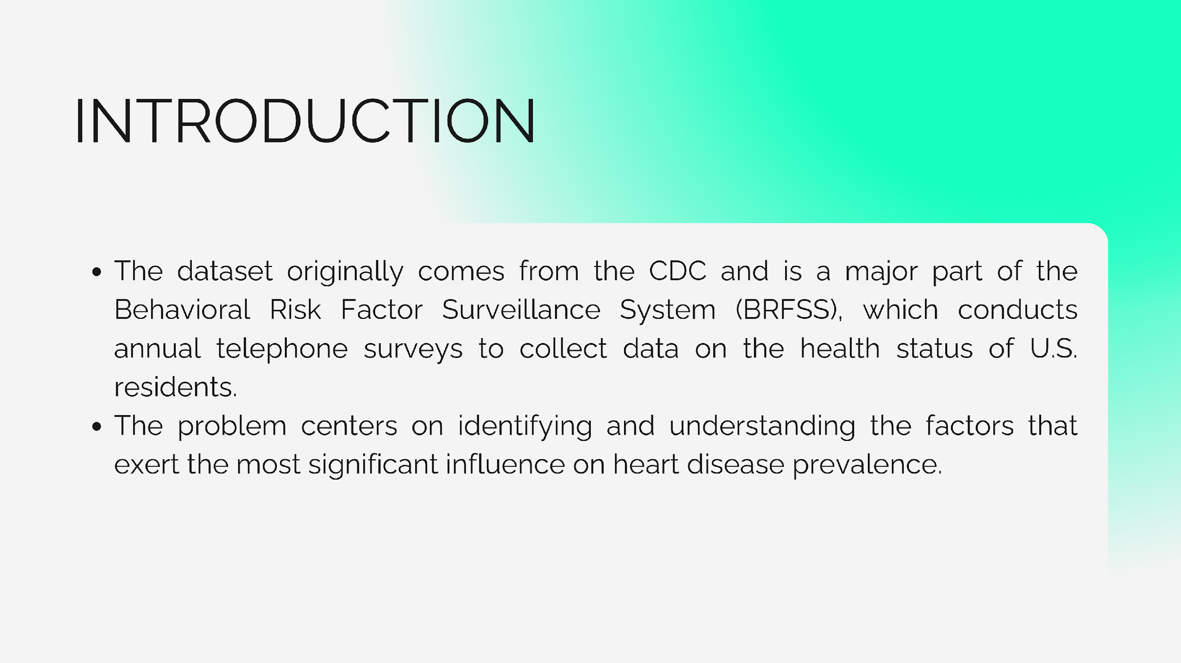

INTRODUCTION
The dataset originally comes from the CDC and is a major part of the Behavioral Risk Factor Surveillance System (BRFSS), which conducts annual telephone surveys to collect data on the health status of U.S. residents.
The problem centers on identifying and understanding the factors that exert the most significant influence on heart disease prevalence.

Slide 3
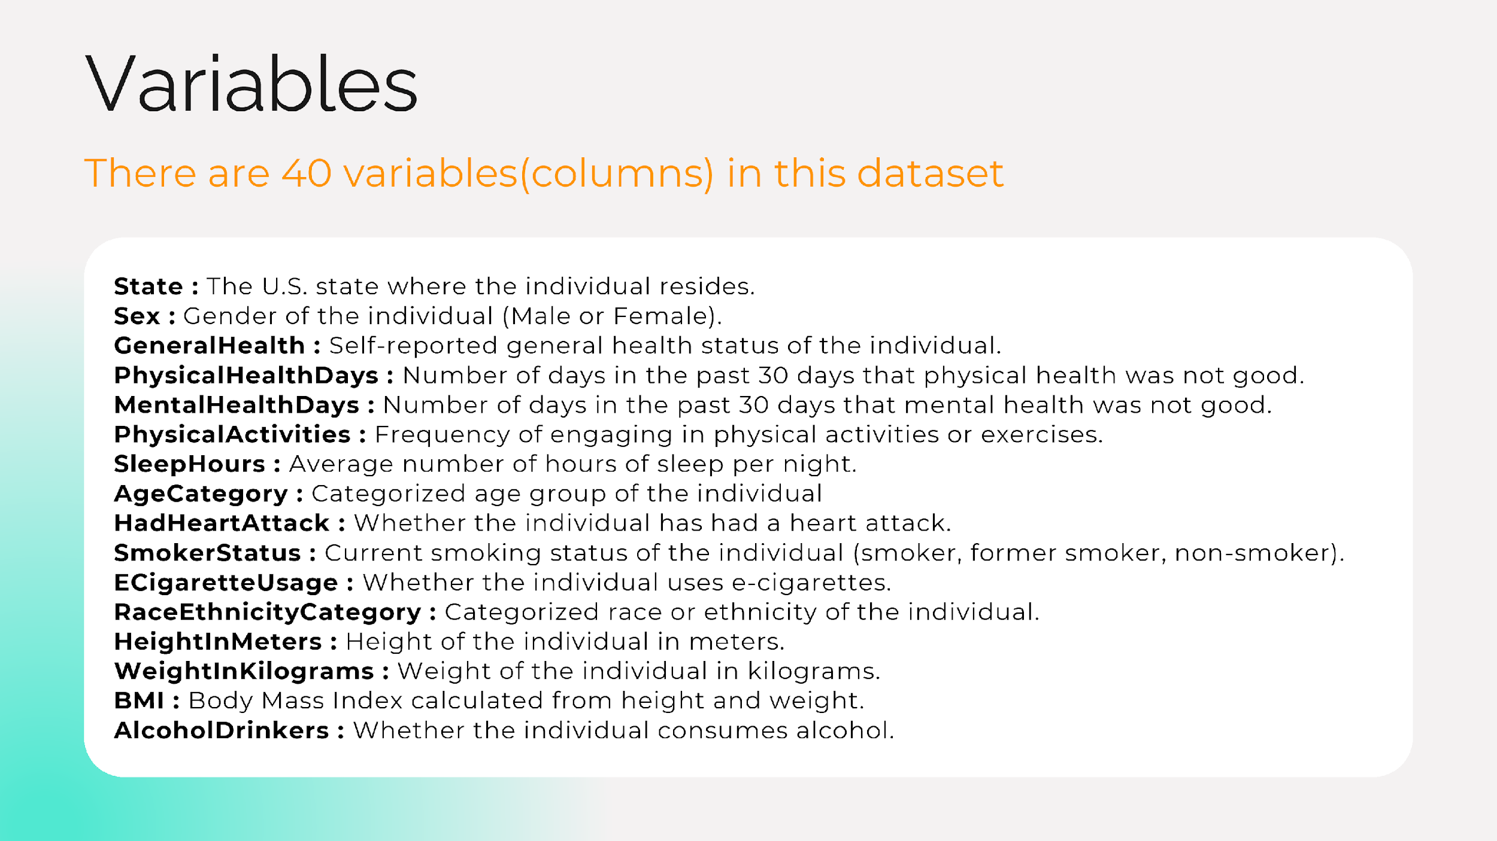
Variables in our dataset
Variables:¶
There are 40 variables(columns) in this dataset ,out of which we worked on these
State : The U.S. state where the individual resides.
Sex : Gender of the individual (Male or Female).
GeneralHealth : Self-reported general health status of the individual.
PhysicalHealthDays : Number of days in the past 30 days that physical health was not good.
MentalHealthDays : Number of days in the past 30 days that mental health was not good.
PhysicalActivities : Frequency of engaging in physical activities or exercises.
SleepHours : Average number of hours of sleep per night.
AgeCategory : Categorized age group of the individual
HadHeartAttack : Whether the individual has had a heart attack.
SmokerStatus : Current smoking status of the individual (smoker, former smoker, non-smoker).
ECigaretteUsage : Whether the individual uses e-cigarettes.
RaceEthnicityCategory : Categorized race or ethnicity of the individual.
HeightInMeters : Height of the individual in meters.
WeightInKilograms : Weight of the individual in kilograms.
BMI : Body Mass Index calculated from height and weight.
AlcoholDrinkers : Whether the individual consumes alcohol.

Slide 4
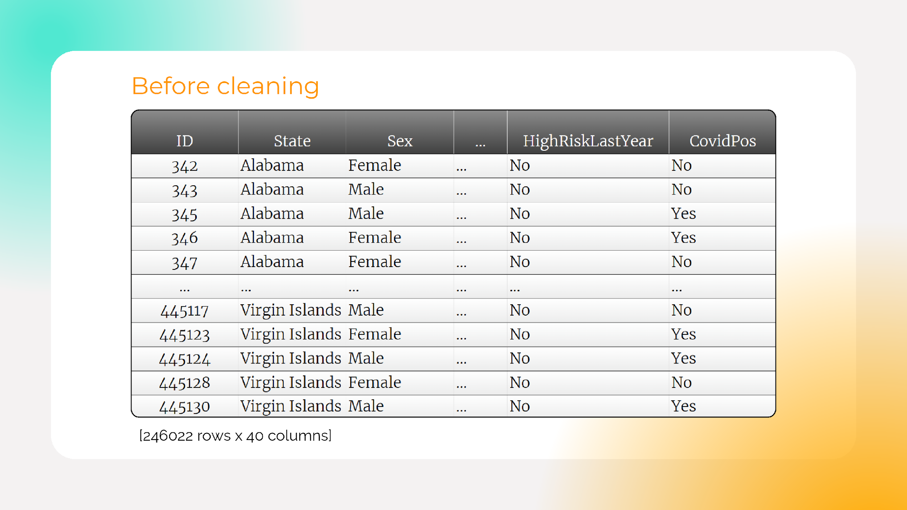
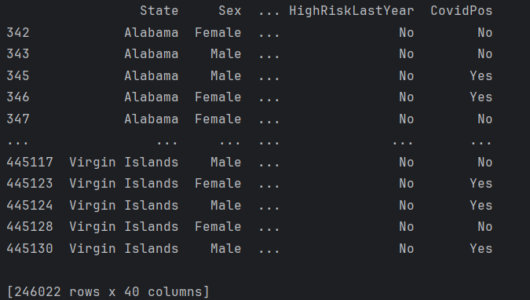
Before cleaning

Slide 5
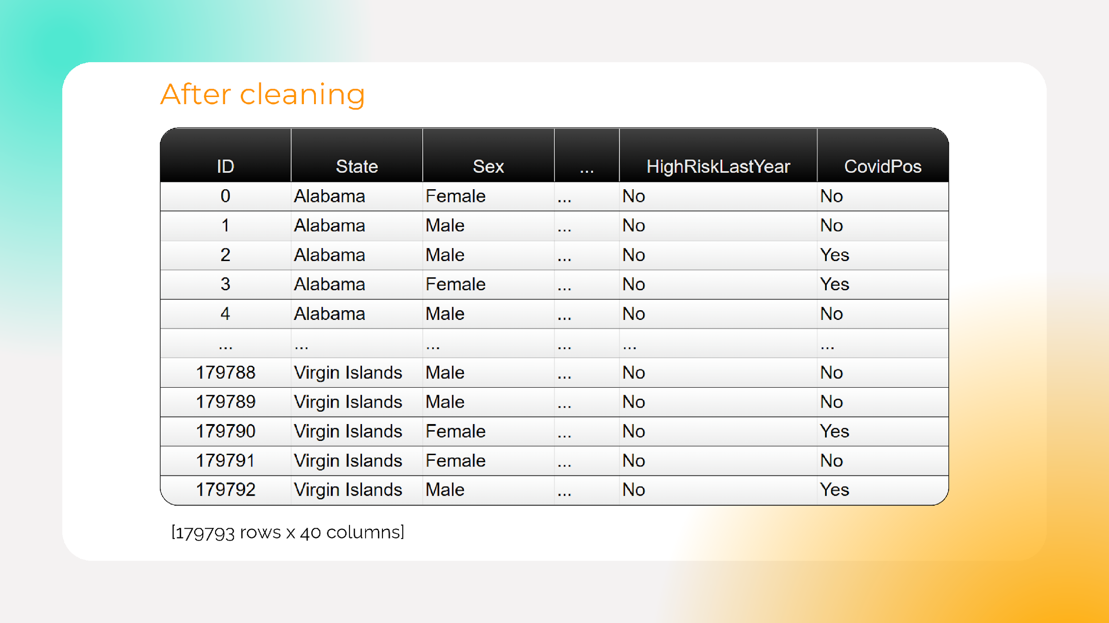
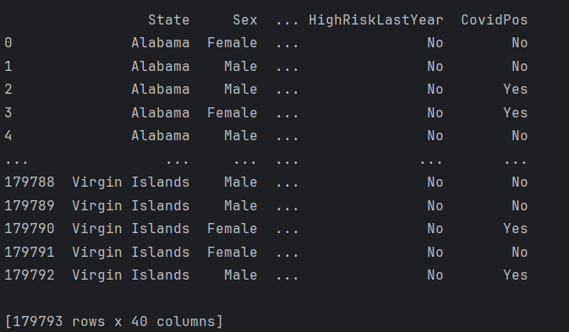
After Cleaning

Slide 6
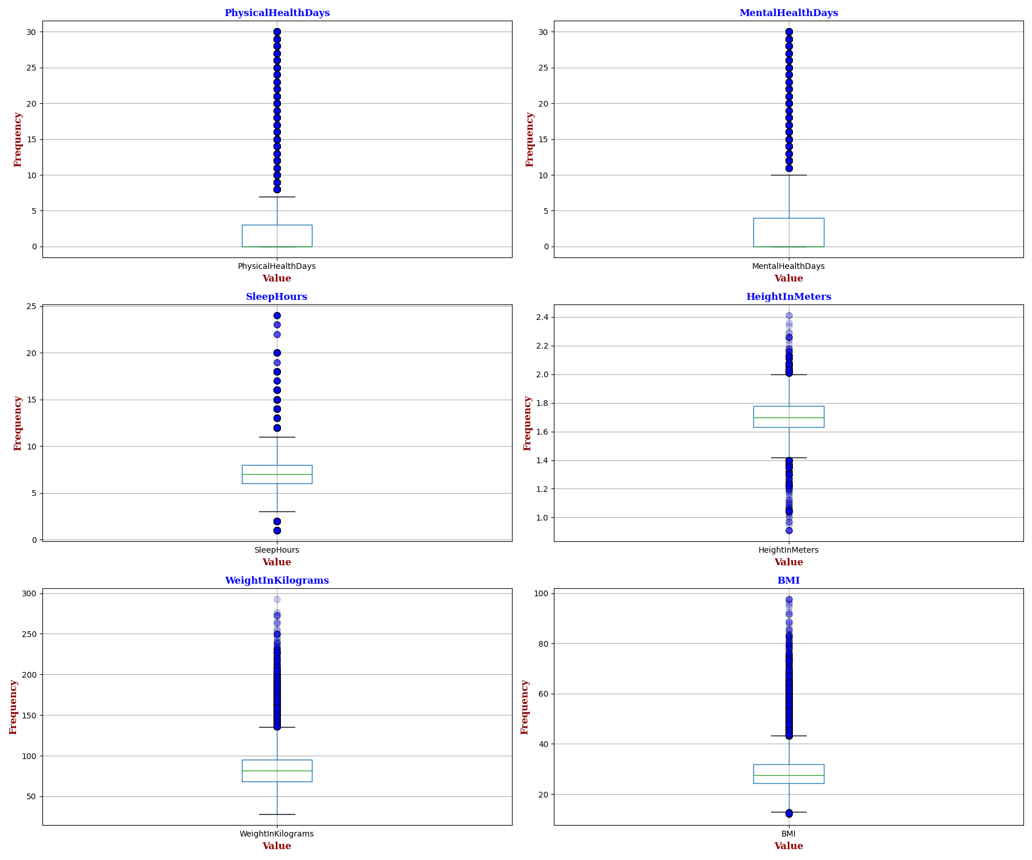
Outliers in dataset

Slide 7
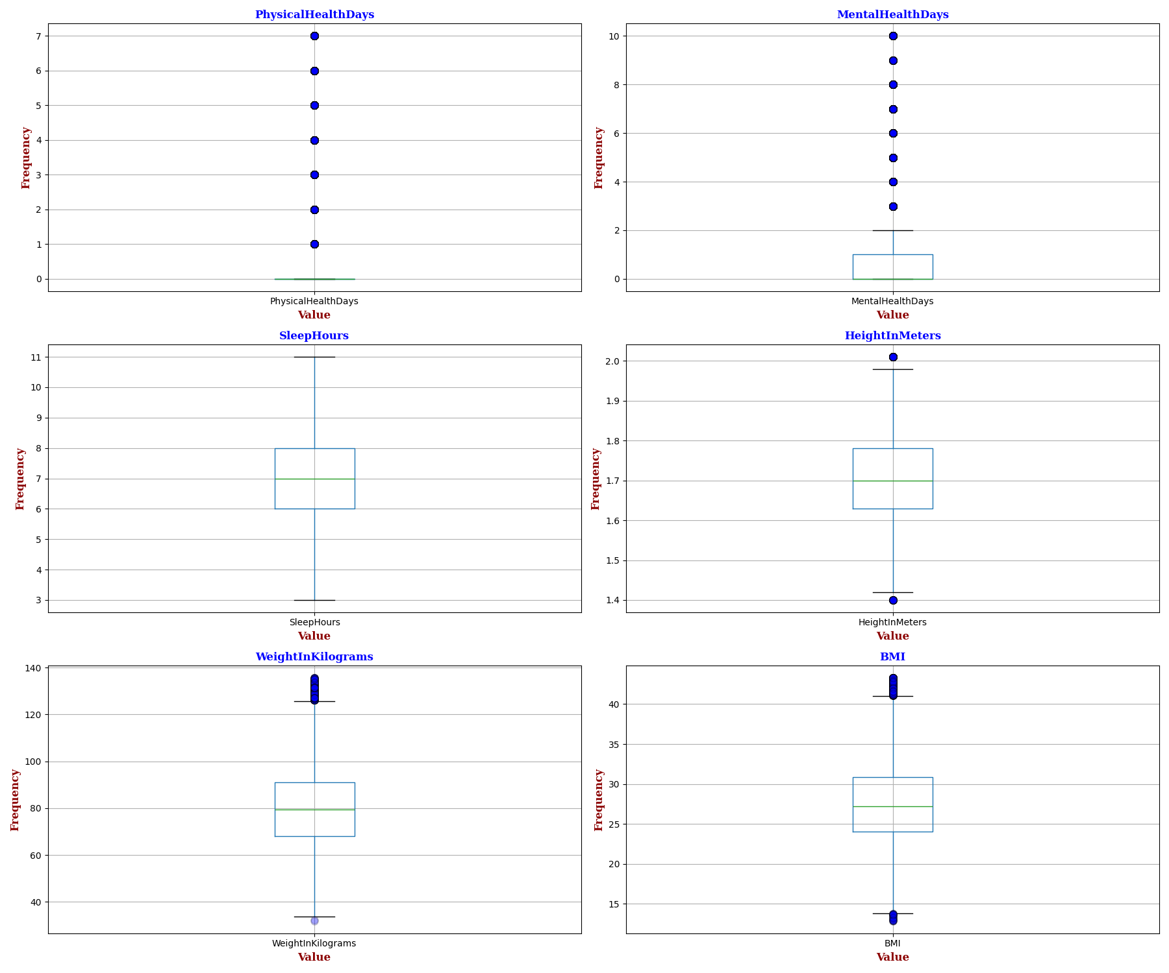
After Outlier removal

Slide 8
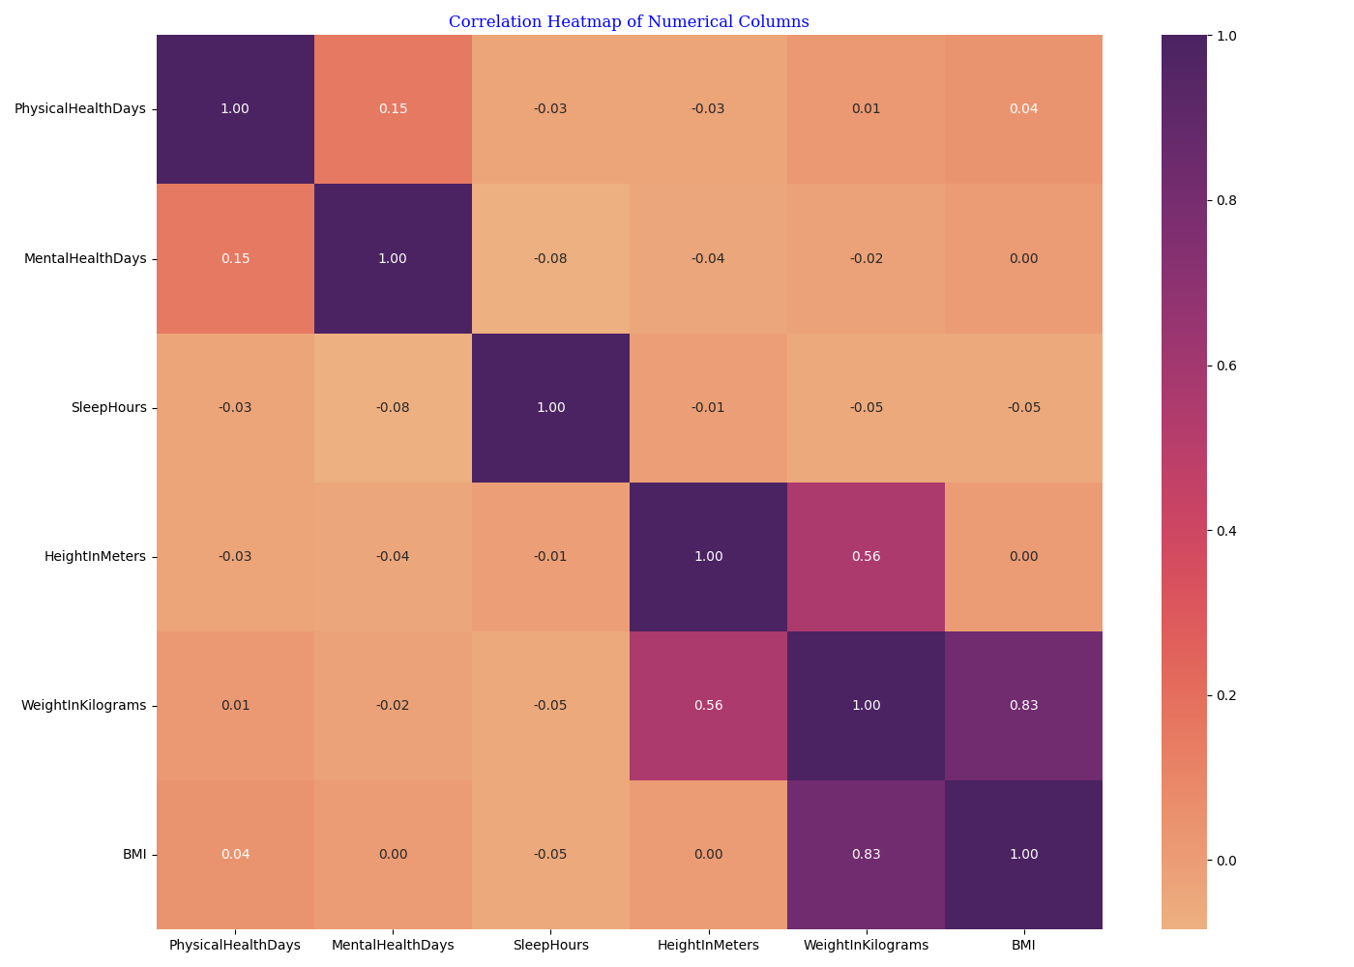
Correlation Heatmap of Numerical Columns
WeightInKilograms and BMI (0.83): There's a strong positive correlation
HeightInMeters and WeightInKilograms (0.56): A moderate positive correlation
PhysicalHealthDays and MentalHealthDays (0.15): A weak positive correlation implies a slight tendency for individuals with more physically unhealthy days to also have more mentally unhealthy days.

Slide 9
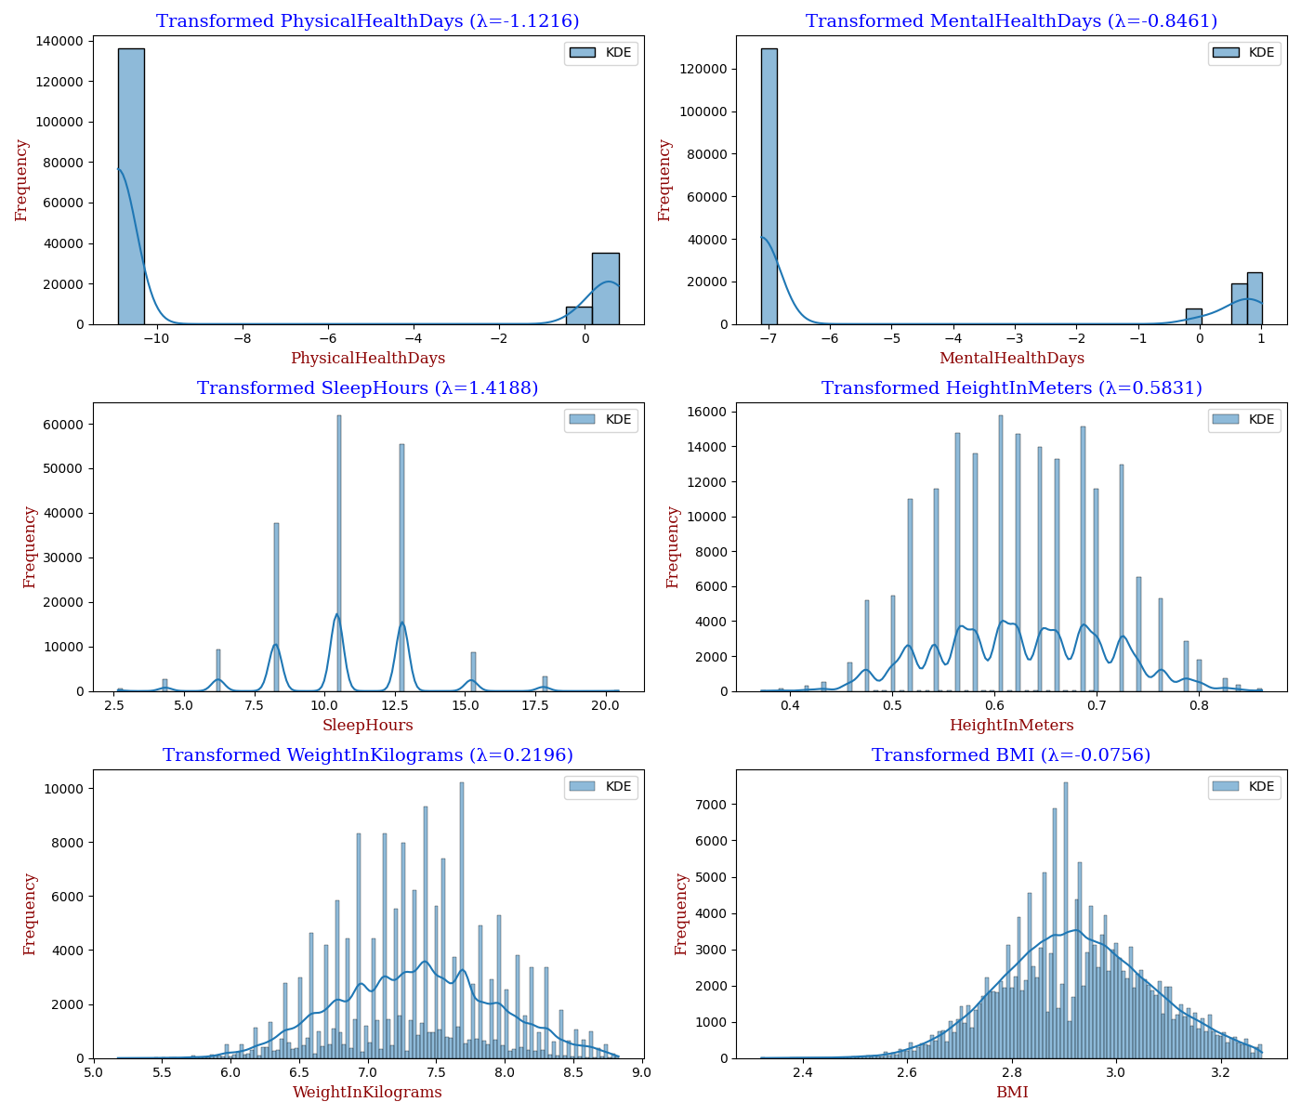
Transforming our dataset to normalise
Histograms with KDE curves, displaying Box-Cox transformed distributions for variables like health metrics, sleep, height, weight, and BMI. Each transformation's efficacy is noted by its unique λ value.
Stabilize variance and make the data more closely resemble a normal distribution.

Slide 10
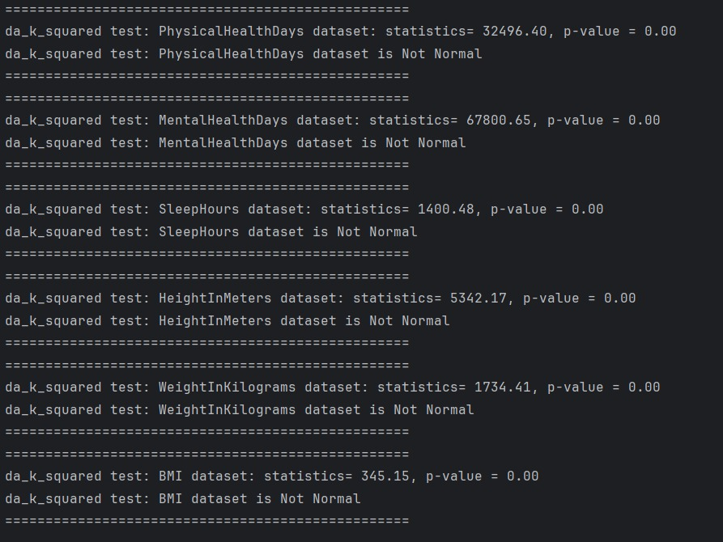
Normality test using D'Agostino's K-squared test on Transformed Data
The very low p-values suggest strong evidence against the null hypothesis of normality.
The datasets for PhysicalHealthDays, MentalHealthDays, SleepHours, HeightInMeters, WeightInKilograms, and BMI are not normally distributed.
The test statistic values are indicators of the degree of non-normality, with higher values indicating greater deviation from normality.

Slide 11

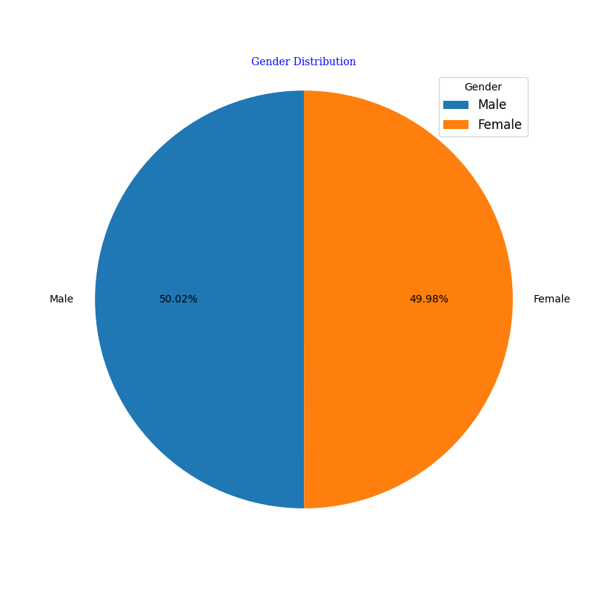
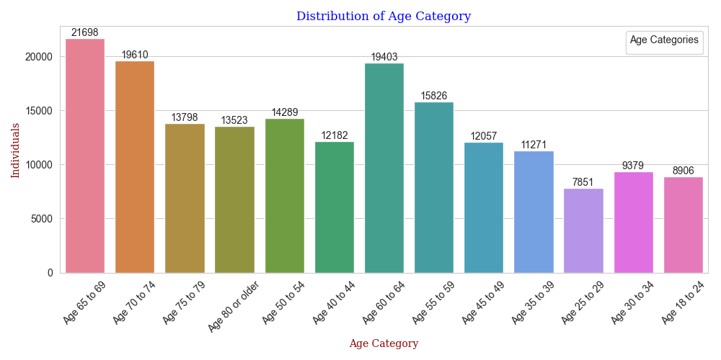
Demographic Variation:
How does the prevalence of heart disease and major risk factors vary across different demographic groups (sex, age, race/ethnicity)
Above piechart shows that females are more than males in the data population.
Mostly individuals are aged around 65-69
Mostly individuals are aged around 65-69

Slide 12
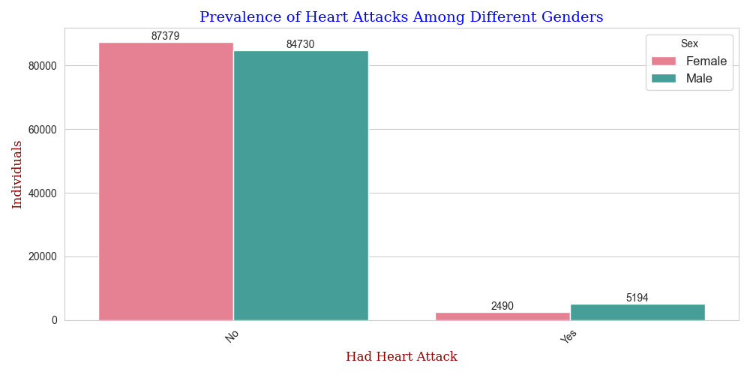
Many individuals did not experience any heart disease. However, among those who did, the majority were males

Slide 13

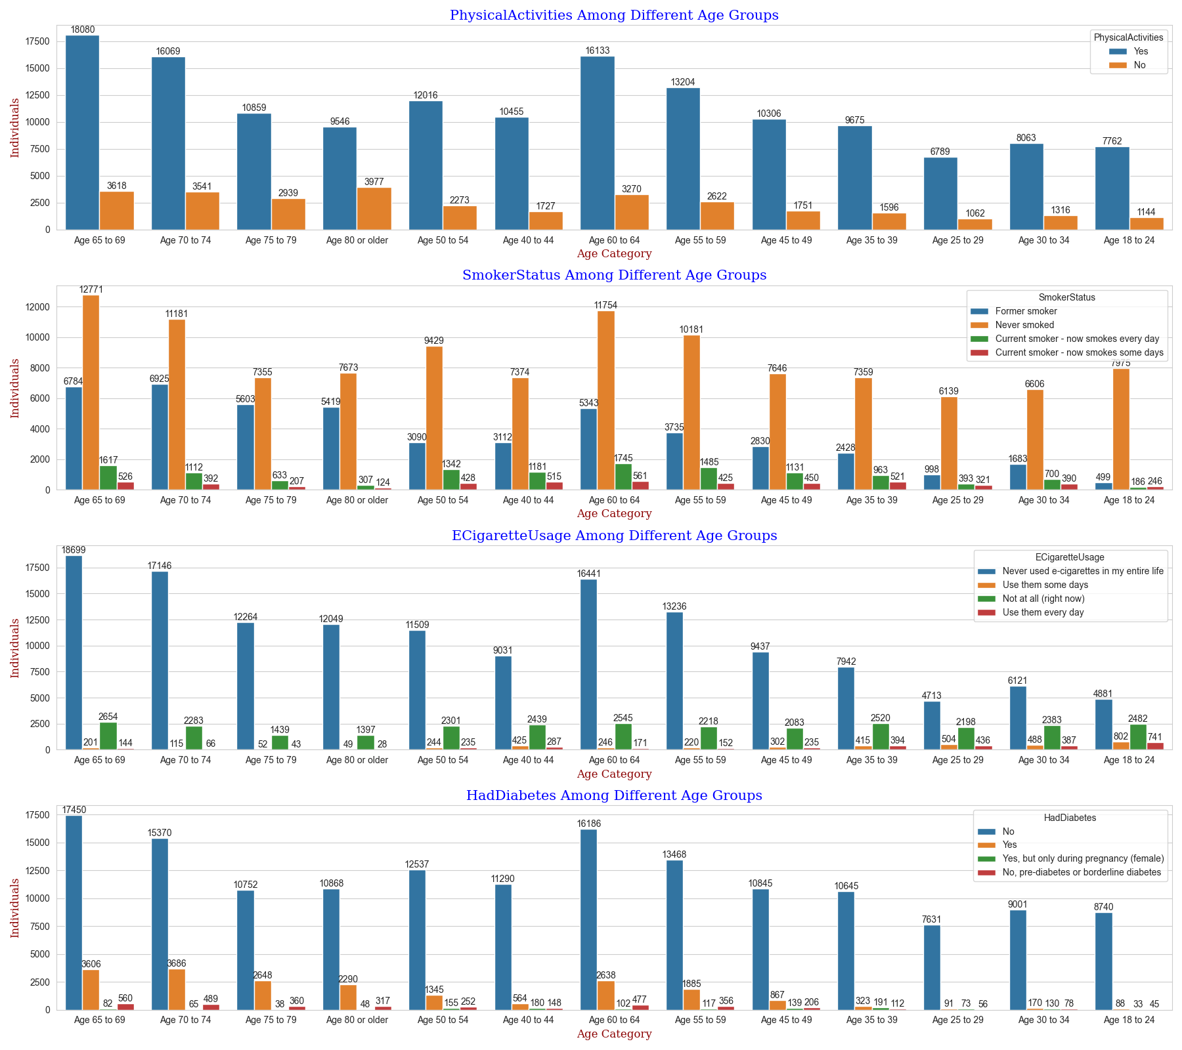
Most individuals aged around 65-69 are physically active
Most individuals aged between 60 and 64 engage in regular smoking, while those aged 70 to 74 comprise a larger proportion of former smokers.
The use of e-cigarettes is popular among individuals aged 18 to 24, as they use e-cigarettes every day more frequently than other age groups.
Individuals aged 70 to 74 have a higher proportion of diabetes compared to other age groups. However, individuals between 18 and 30 do not have as much diabetes.

Slide 14
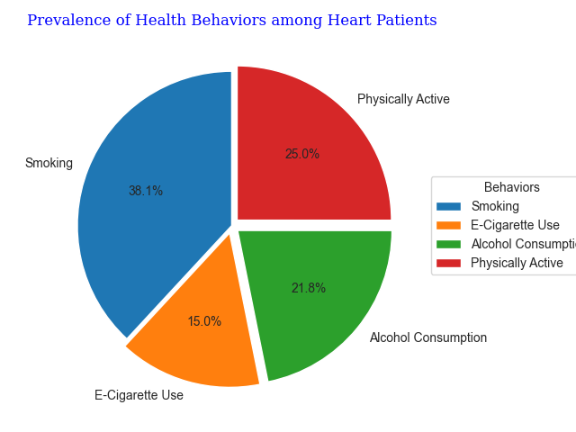
Females experience a higher percentage of days with poor physical health and poor mental health compared to males. This means that, on average, females report more days of poor physical and mental health in the past 30 days than males. The average number of sleep hours is quite similar between males and females.

Slide 15
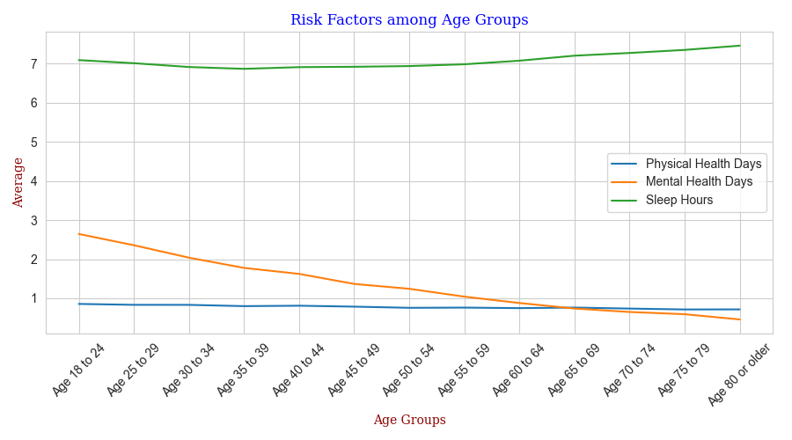
As people age, the number of days with reported poor physical health remains quite stable, showing only a marginal increase across age groups.
The number of days with poor mental health reported actually decreases as individuals age, contrary to the initial statement that older individuals experience fewer days with poor mental health.
Sleep duration does not vary significantly with age, with a slight increase in sleep hours noted in individuals aged 65 and above. The initial statement aligns with the graph, which indicates that sleep hours might increase slightly for the oldest age groups.

Slide 16
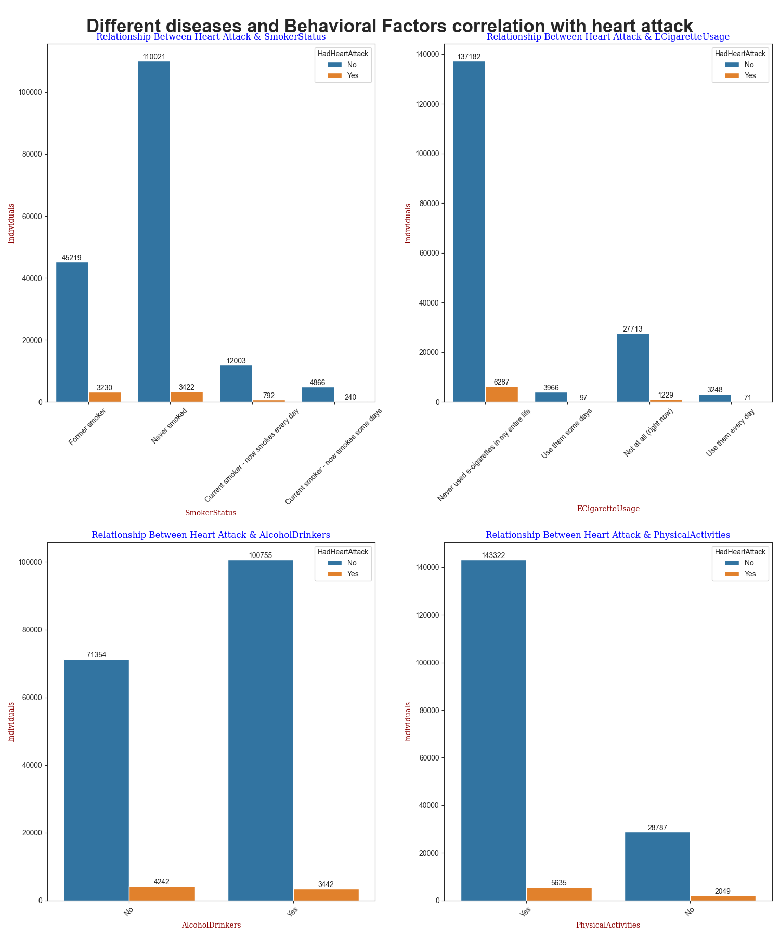
Explore the relationships between health behaviors (physical activity, alcohol consumption etc) and the prevalence of heart disease
The health behaviors may include Physical Activity, Alcohol Drinkers,smoking, e-cigarette use, relate to heart diseases. Individuals who used to smoke in the past are often affected by heart attacks. Additionally, it's noteworthy that individuals who have never used e-cigarettes and do not consume alcohol also experience heart attacks,and individuals who are active in physical activity also experienced which is quite surprising

Slide 17
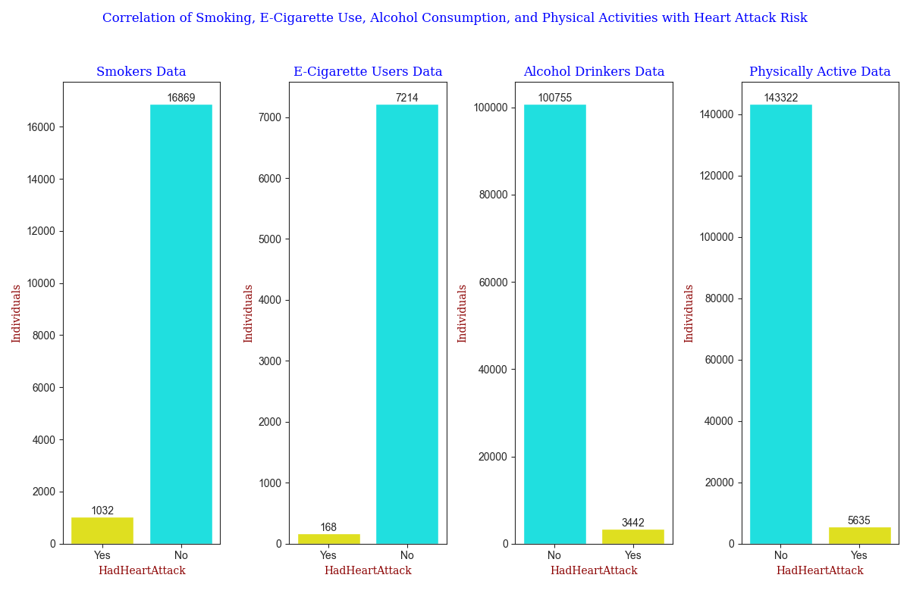
Investigating how the presence of these factors is connected to the prevalence of heart disease
Smokers: Both smokers and non-smokers experience heart attacks, but most smokers haven't had one.
E-Cigarette Users: Like smoking, more e-cigarette users avoid heart attacks than suffer them, showing a link but no direct cause of heart attacks.
Alcohol Drinkers: Most people who drink alcohol don't have heart attacks, indicating a potential link but no clear cause.
Physically Active: Being active is more common among those without heart attacks, suggesting that exercise might help prevent them.

Slide 18
People who smoke are at a higher risk of developing heart disease or experiencing a heart attack

Slide 19
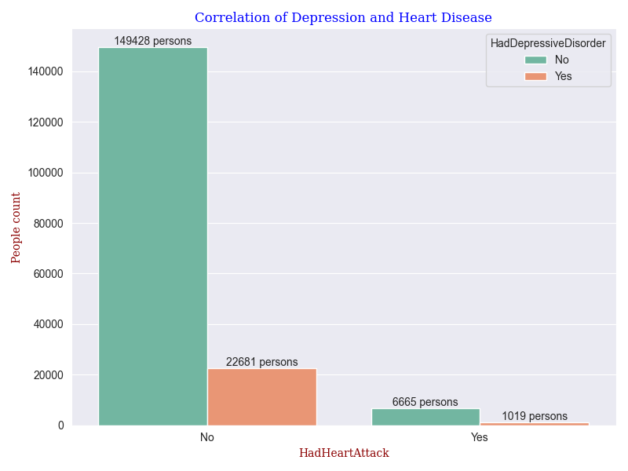
Effect of Mental Health on Heart Disease
This chart shows that most of the people neither have heart disease nor depressive disorder.
Among people having heart problems, a significant big portion of 6000+ have depressive disorders also.

Slide 20
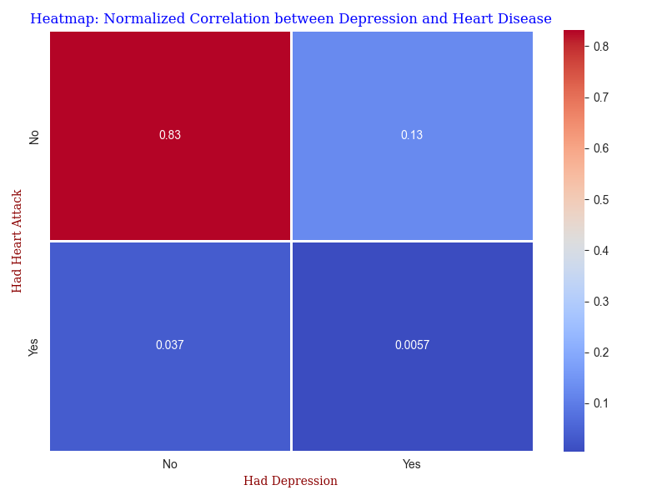
Mostly 83% people do not have depressive disorder and also have a good heart health.
13% people are suffering from depression but also don't have a heart disease.
Around 4% people don't have depressive disorder but facing heart disease.
Very few people i.e around 0.57% have faced depressive disorder before developing heart problems.

Slide 21
Conclusion
Study underscores the complexity of heart disease prevalence, which is influenced by a myriad of factors including age, sex, health behaviors, and lifestyle choices. Smoking was identified as a significant risk factor, but the surprising prevalence of heart disease among physically active individuals and non-users of e-cigarettes and alcohol suggests that heart disease is a multifaceted issue requiring a holistic approach to prevention and treatment.
The color intensity of heatmap and the values, thereby indicate that having a depressive disorder is less common among those who had a heart attack than among those who did not.
Overall, the heatmap indicates that the strongest relationship is between not having depression and not having a heart attack. However, the presence of depression does not seem to have a strong correlation with the occurrence of a heart attack within this dataset.

Slide 22
THANK YOU Link for Dashboard: https://dashapp-txdi7nwftq-ue.a.run.app/

